Slide 1
Module 5: Wireless Network Communication
Instructor Materials
Cybersecurity Essentials 3.0
Notes:
Cybersecurity Essentials 3.0
Module 5: Wireless Network Communication

Slide 2
Instructor Materials – Module 5 Planning Guide
This PowerPoint deck is divided in two parts:
Instructor Planning Guide
  Information to help you become familiar with the module
  Teaching aids
Instructor Class Presentation
  Optional slides that you can use in the classroom
  Begins on slide # 9
  Note: Remove the Planning Guide from this presentation before sharing with anyone.

Slide 3
What to Expect in this Module
To facilitate learning, the following features within the UI may be included in this module:
Feature | Description
Avatar | A virtual character, representing a subject matter expert, adds additional contextual information to skills the students have learned and helps them connecting the dots, by asking open reflection questions.
Animations | Expose learners to new skills and concepts.
Videos | Expose learners to new skills and concepts.
Check Your Understanding | Per topic online quiz to help learners gauge content understanding.
Interactive Activities | A variety of formats to help learners gauge content understanding.
Syntax Checker | Small simulations that expose learners to Cisco command line to practice configuration skills.
PT Activity | Simulation and modeling activities designed to explore, acquire, reinforce, and expand skills.

Slide 4
What to Expect in this Module (Cont.)
To facilitate learning, the following features within the UI may be included in this module:
Feature | Description
Hands-On Labs | Labs designed for working with physical equipment.
Module Quizzes | Self-assessments that integrate concepts and skills learned throughout the series of topics presented in the module.
Module Summary | Briefly recaps module content.

Slide 5
Check Your Understanding
Check Your Understanding activities are designed to let students quickly determine if they understand the content and can proceed, or if they need to review.
Check Your Understanding activities do not affect student grades.
There are no separate slides for these activities in the PPT. They are listed in the notes area of the slide that appears before these activities.

Slide 6
Module 5: Activities
What activities are associated with this module?
Page # | Activity | Activity Name | Optional?
5.1.1 | Video | Video - WLAN Operation | Recommended
5.1.7 | Check Your Understanding | Check Your Understanding -Steps in the Client and AP Process | Recommended
5.1.9 | Check Your Understanding | Check Your Understanding -Identify the LAN Device | Recommended
5.2.1 | Video | Video – WLAN Threats | Recommended
5.2.6 | Check Your Understanding | Check Your Understanding - WLAN Threats | Recommended
5.3.1 | Video | Video – Secure WLANs | Recommended
5.3.9 | Check Your Understanding | Check Your Understanding - Secure WLANs | Recommended
5.3.10 | PT Activity | Packet Tracer – Configure Basic Wireless Security | Recommended
5.3.11 | PT Activity | Packet Tracer – Troubleshoot a Wireless Connection | Recommended
Activity Wizard Password: PT_csp11

Slide 7
Module 5: Best Practices
Prior to teaching Module 5, the instructor should:​
Review the activities and assessments for this module.​
Try to include as many questions as possible to keep students engaged during classroom presentation.​
​
Topic 5.1​
Ask the class to watch the 5.1.1 Video about WLAN operation.
Explain the differences between Wired LANs and Wireless LANs.
Describe the CSMA/CA method and point the differences with the CSMA/CD method.
Explain how wireless clients associate with an AP or wireless router.
Topic 5.2
Recommend the students to watch the 5.2.1 Video about WLAN threats.
Ask the students to give examples of threats to wireless networks.
Explain the types of wireless attacks and give examples in the real world.

Slide 8
Module 5: Best Practices (Cont.)
Topic 5.3
Ask the class to watch the 5.3.1 Video about WLANs security.
Explain each technique to secure WLANs: SSID cloaking, MAC address filtering, authentication methods, and encryption methods.
Introduce the AAA method for secure Enterprise WLANs using RADIUS server.

Slide 9
Module 5: Wireless Network Communication
Cybersecurity Essentials 3.0
Notes:
Cybersecurity Essentials 3.0
Module 5: Wireless Network Communication

Slide 10
Module Objectives
Module Title: Wireless Network Communication
Module Objective: Troubleshoot a wireless network.
Topic Title | Topic Objective
Wireless Communications | Explain how wireless devices enable network communication.
WLAN Threats | Describe threats to WLANs.
Secure WLANs | Troubleshoot a wireless connection.

Slide 11
5.1 Wireless Communications
Notes:
5: Wireless Network Communication
5.1: Wireless Communications

Slide 12
Wireless Communications
Video - WLAN Operation
This video will cover the following:
Infrastructure Mode
Ad hoc mode
Tethering
Basic Service Set (BSS)
Extended Service Set (ESS)
802.11 Frame Structure
Carrier Sense Multiple Access Collision Avoidance (CSMA/CA)
Wireless Client and AP Association
Passive and Active Discovery Mode
Notes:
5: Wireless Network Communication
5.1: Wireless Communications
5.1.1: Video - WLAN Operation

Slide 13
Wireless Communications
Wireless versus Wired LANs
The table summarizes the differences between wireless and wired LANs.
Characteristic | 802.11 Wireless LAN | 802.3 Wired Ethernet LANs
Physical Layer | radio frequency (RF) | physical cables
Media Access | collision avoidance | collision detection
Availability | anyone with a wireless NIC in range of an access point | physical cable connection required
Signal Interference | yes | minimal
Regulation | different regulations by country | IEEE standard dictates
Notes:
5: Wireless Network Communication
5.1: Wireless Communications
5.1.2: Wireless versus Wired LANs

Slide 14
Wireless Communications
802.11 Frame Structure
All Layer 2 frames consist of a header, payload, and Frame Check Sequence (FCS) section. The 802.11 frame format is like the Ethernet frame format, except that it contains more fields.
Frame Control – It identifies the type of wireless frame and contains subfields for protocol version, frame type, address type, power management, and security settings.
Duration - It is typically used to indicate the remaining duration needed to receive the next frame transmission.
Address1 - It usually contains the MAC address of the receiving wireless device or AP.
Address2 - It usually contains the MAC address of the transmitting wireless device or AP.
Address3 – It sometimes contains the destination MAC address, such as the default gateway to which the AP is attached.
Sequence Control - It contains information to control sequencing and fragmented frames.
Address4 - It is usually missing because it is used only in ad hoc mode.
Payload – It contains the data for transmission.
FCS - It is used for Layer 2 error control.
Notes:
5: Wireless Network Communication
5.1: Wireless Communications
5.1.3: 802.11 Frame Structure

Slide 15
Wireless Communications
CSMA/CA
WLANs are half-duplex, shared media configurations. This creates a problem because a wireless client cannot hear while it is sending, which makes it impossible to detect a collision.
To resolve this problem, WLANs use CSMA/CA as the method to determine how and when to send data on the network. A wireless client does the following:
Listens to the channel (carrier) to see if it senses no other traffic on the channel (idle).
Sends a ready to send (RTS) message to the AP to request dedicated access to the network.
Receives a clear to send (CTS) message from the AP granting access to send.
If the wireless client does not receive a CTS message, it waits a random amount of time to restart the process.
After it receives the CTS, it transmits the data.
All transmissions are acknowledged. If a wireless client does not receive an acknowledgment, it assumes a collision occurred and restarts the process.
Notes:
5: Wireless Network Communication
5.1: Wireless Communications
5.1.4: CSMA/CA

Slide 16
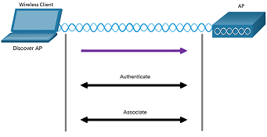
Wireless Communications
Wireless Client and AP Association
For wireless devices to communicate over a network, they must first associate with an AP or wireless router. An important part of the 802.11 process is discovering a WLAN and subsequently connecting to it.
Wireless devices complete the following three stage process:
Discover a wireless AP
Authenticate with AP
Associate with AP
Notes:
5: Wireless Network Communication
5.1: Wireless Communications
5.1.5: Wireless Client and AP Association

Slide 17
Wireless Communications
Wireless Client and AP Association (Cont.)
A wireless client and an AP must agree on specific parameters that must be configured on the AP and subsequently on the client to enable the negotiation of a successful association.
SSID – It appears in the list of available wireless networks on a client.
Password - It is required from the wireless client to authenticate to the AP.
Network mode - It refers to the 802.11a/b/g/n/ac/ad WLAN standards.
Security mode – It refers to the security parameter settings, such as WEP, WPA, or WPA2.
Channel settings – It refers to the frequency bands used to transmit wireless data.
Notes:
5: Wireless Network Communication
5.1: Wireless Communications
5.1.5: Wireless Client and AP Association (Cont.)

Slide 18
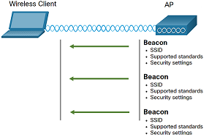
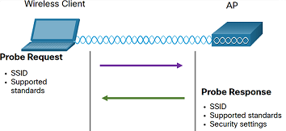
Wireless Communications
Passive and Active Discover Mode
Wireless devices must discover and connect to an AP or wireless router. Wireless clients connect to the AP using a scanning (probing) process. This process can be passive or active.
Passive mode
The AP openly advertises its service by periodically sending broadcast beacon frames containing the SSID, supported standards, and security settings.
Active mode
Wireless clients must know the name of the SSID and initiate the process by broadcasting a probe request frame on multiple channels.
APs configured with the SSID will send a probe response that includes the SSID, supported standards, and security settings.
Notes:
5: Wireless Network Communication
5.1: Wireless Communications
5.1.6: Passive and Active Discover Mode
5.1.7: Check Your Understanding – Steps in the Client and AP Process

Slide 19
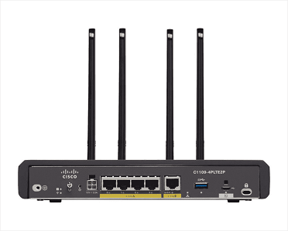
Wireless Communications
Wireless Devices - AP, LWAP, and WLC
Home and small business wireless routers integrate the functions of a router, switch, and access point into one device.
All the control and management functions of the APs on a network can be centralized into a Wireless LAN Controller (WLC).
When using a WLC, the APs no longer act autonomously, but instead act as lightweight APs (LWAPs).
LWAPs only forward data between the wireless LAN and the WLC.
A Major benefit of centralizing the AP management functions in the WLC is simplified configuration and monitoring of numerous access points.
Notes:
5: Wireless Network Communication
5.1: Wireless Communications
5.1.8: Wireless Devices - AP, LWAP, and WLC
5.1.9: Check Your Understanding - Identify the LAN Device

Slide 20
5.2 WLAN Threats
Notes:
5: Wireless Network Communication
5.2: WLAN Threats

Slide 21
WLAN Threats
Video - WLAN Threats
This video will cover the following:
Interception of Data
Wireless Intruders
Denial of Service (DoS) Attacks
Rogue APs
Notes:
5: Wireless Network Communication
5.2: WLAN Threats
5.2.1: Video - WLAN Threats

Slide 22
WLAN Threats
Wireless Security Overview
With a wireless NIC and knowledge of cracking techniques, an attacker may not have to physically enter the workplace to gain access to a WLAN.
Wireless networks are specifically susceptible to several threats, including:
Interception of data - Wireless data should be encrypted to prevent it from being read by eavesdroppers.
Wireless intruders - Unauthorized users attempting to access network resources can be deterred through effective authentication techniques.
Denial of Service (DoS) Attacks - Access to WLAN services can be compromised either accidentally or maliciously.
Rogue APs - Unauthorized APs installed by a well-intentioned user or for malicious purposes can be detected using management software.
Notes:
5: Wireless Network Communication
5.2: WLAN Threats
5.2.2: Wireless Security Overview

Slide 23
WLAN Threats
DoS Attacks
Wireless DoS attacks can be the result of:
Improperly configured devices - Configuration errors can disable the WLAN.
A malicious user intentionally interfering with the wireless communication - Their goal is to disable the wireless network completely or to the point where no legitimate device can access the medium.
Accidental interference - WLANs are prone to interference from other wireless devices (microwave ovens, cordless phones, baby monitors). The 2.4 GHz band is more prone to interference than the 5 GHz band.
To minimize the risk of a DoS attack due to improperly configured devices and malicious attacks, harden all devices, keep passwords secure, create backups, and ensure that all configuration changes are incorporated off-hours.
Notes:
5: Wireless Network Communication
5.2: WLAN Threats
5.2.3: DoS Attacks

Slide 24
WLAN Threats
Rogue Access Points
A rogue AP is an AP or wireless router that has been connected to a corporate network without explicit authorization and against corporate policy.
Anyone with access to the premises can install an inexpensive wireless router that can potentially allow access to a secure network resource.
The connected rogue AP can be used by an attacker to capture MAC addresses, capture data packets, gain access to network resources, or launch a man-in-the-middle attack.
A personal network hotspot could also be used as a rogue AP.
To prevent the installation of rogue APs, organizations must configure WLCs with rogue AP policies and use monitoring software to actively monitor the radio spectrum for unauthorized APs.
Notes:
5: Wireless Network Communication
5.2: WLAN Threats
5.2.4: Rogue Access Points

Slide 25
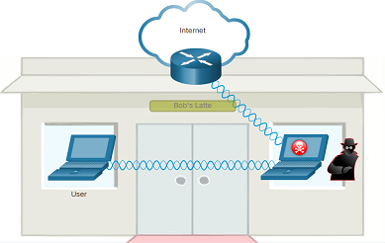
WLAN Threats
Man-in-the-Middle Attack
The hacker is positioned in between two legitimate entities to read or modify the data that passes between the two parties.
"Evil twin AP" attack: an attacker introduces a rogue AP and configures it with the same SSID as a legitimate AP.
Wireless clients attempting to connect to a WLAN see two APs offering wireless access. Those near the rogue AP find the stronger signal and most likely associate with it.
User traffic is now sent to the rogue AP that captures the data and forwards it to the legitimate AP.
Return traffic from the legitimate AP is sent to the rogue AP, captured, and forwarded to the unsuspecting user.
Notes:
5: Wireless Network Communication
5.2: WLAN Threats
5.2.5: Man-in-the-Middle Attack
5.2.6: Check Your Understanding - WLAN Threats

Slide 26
5.3 Secure WLANs
Notes:
5: Wireless Network Communication
5.3: Secure WLANs

Slide 27
Secure WLANs
Video - Secure WLANs
This video will cover the following:
SSID Cloaking
MAC Address Filtering
Authentication and Encryption Systems (Open Authentication and Shared Key Authentication)
Notes:
5: Wireless Network Communication
5.3: Secure WLANs
5.3.1: Video - Secure WLANs

Slide 28
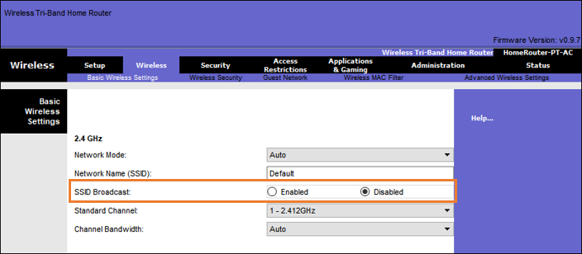
Secure WLANs
SSID Cloaking and MAC Address Filtering
To address the threats of keeping wireless intruders out and protecting data, two early security features were used and are still available on most routers and APs: SSID cloaking and MAC address filtering.
SSID Cloaking
APs and some wireless routers allow the SSID beacon frame to be disabled.
Wireless clients must manually configure the SSID to connect to the network.
Notes:
5: Wireless Network Communication
5.3: Secure WLANs
5.3.2: SSID Cloaking and MAC Address Filtering

Slide 29
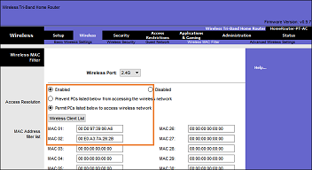
Secure WLANs
SSID Cloaking and MAC Address Filtering (Cont.)
MAC Addresses Filtering
An administrator can manually permit or deny clients wireless access based on their physical MAC hardware address.
In the figure, the router is configured to permit two MAC addresses. Devices with different MAC addresses will not be able to join the 2.4GHz WLAN.
Notes:
5: Wireless Network Communication
5.3: Secure WLANs
5.3.2: SSID Cloaking and MAC Address Filtering (Cont.)

Slide 30
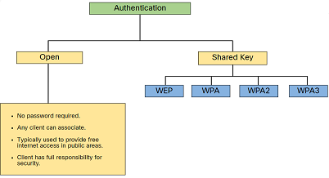
Secure WLANs
802.11 Original Authentication Methods
SSIDs are easily discovered even if APs do not broadcast them, and MAC addresses can be spoofed.
The best way to secure a wireless network is to use authentication and encryption systems.
Two types of authentication were introduced with the original 802.11 standard:
Open system authentication - Any wireless client can easily connect and should only be used when security is of no concern.
Shared key authentication - Provides mechanisms (WEP, WPA, WPA2, and WPA3) to authenticate and encrypt data between a wireless client and AP.
Notes:
5: Wireless Network Communication
5.3: Secure WLANs
5.3.3: 802.11 Original Authentication Methods

Slide 31
Secure WLANs
Shared Key Authentication Methods
There are four shared key authentication techniques available. Until the availability of WPA3 devices becomes ubiquitous, wireless networks should use the WPA2 standard.
Authentication Method | Description
Wired Equivalent Privacy (WEP) | The original 802.11 specification designed to secure the data using the Rivest Cipher 4 (RC4) encryption method with a static key. However, the key never changes when exchanging packets. This makes it easy to hack. WEP is no longer recommended and should never be used.
Wi-Fi Protected Access (WPA) | A Wi-Fi Alliance standard that uses WEP but secures the data with the much stronger Temporal Key Integrity Protocol (TKIP) encryption algorithm. TKIP changes the key for each packet, making it much more difficult to hack.
WPA2 | WPA2 is the current industry standard for securing wireless networks. It uses the Advanced Encryption Standard (AES) for encryption. AES is currently considered the strongest encryption protocol.
WPA3 | The next generation of Wi-Fi security, WPA3-enabled devices use the latest security methods, disallow outdated legacy protocols, and require the use of Protected Management Frames (PMF). However, devices with WPA3 are not yet readily available.
Notes:
5: Wireless Network Communication
5.3: Secure WLANs
5.3.4: Shared Key Authentication Methods

Slide 32
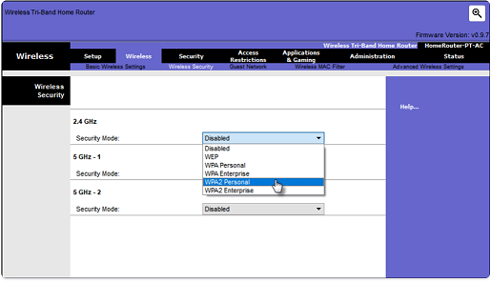
Secure WLANs
Authenticating a Home User
Home routers typically have two choices for authentication: WPA and WPA2 (stronger). Two WPA2 authentication methods are:
Personal
Intended for home or small office networks, users authenticate using a pre-shared key (PSK).
Wireless clients authenticate with the wireless router using a pre-shared password.
Enterprise
Intended for enterprise networks but requires a Remote Authentication Dial-In User Service (RADIUS) authentication server.
The device must be authenticated by the RADIUS server and then users must authenticate using 802.1X standard Extensible Authentication Protocol (EAP).
Notes:
5: Wireless Network Communication
5.3: Secure WLANs
5.3.5: Authenticating a Home User

Slide 33
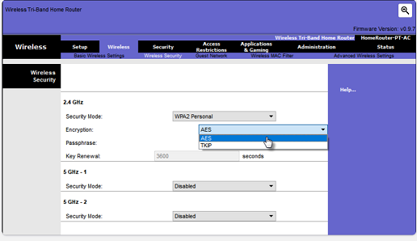
Secure WLANs
Encryption Methods
The WPA and WPA2 standards use the following encryption protocols:
Temporal Key Integrity Protocol (TKIP)
It is used by WPA and provides support for legacy WLAN equipment by addressing the original flaws associated with WEP encryption.
Advanced Encryption Standard (AES)
It is used by WPA2 and the preferred method because it is a far stronger method of encryption.
It uses Counter Cipher Mode with Block Chaining Message Authentication Code Protocol (CCMP) that allows destination hosts to recognize if the encrypted and non-encrypted bits have been altered.
Notes:
5: Wireless Network Communication
5.3: Secure WLANs
5.3.6: Encryption Methods

Slide 34
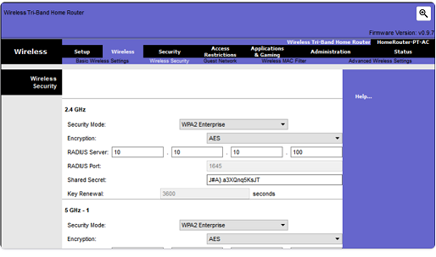
Secure WLANs
Authentication in the Enterprise
In networks that have stricter security requirements, an additional authentication or login is required to grant wireless clients such access.
The Enterprise security mode choice requires an Authentication, Authorization, and Accounting (AAA) RADIUS server.
RADIUS Server IP address: The reachable address of the RADIUS server.
UDP port numbers: Officially assigned UDP ports 1812 for RADIUS Authentication, and 1813 for RADIUS Accounting, but can also operate using UDP ports 1645 and 1646.
Shared key - Used to authenticate the AP with the RADIUS server.
Notes:
5: Wireless Network Communication
5.3: Secure WLANs
5.3.7: Authentication in the Enterprise

Slide 35
Secure WLANs
WPA3
At the time of this writing, devices that support WPA3 authentication were not readily available. However, WPA2 is no longer considered secure.
WPA3, if available, is the recommended 802.11 authentication method.
WPA3 includes four features:
WPA3-Personal
WPA3-Enterprise
Open Networks
Internet of Things (IoT) Onboarding
Notes:
5: Wireless Network Communication
5.3: Secure WLANs
5.3.8: WPA3
5.3.9: Check Your Understanding - Secure WLANs

Slide 36
Secure WLANs
Packet Tracer - Configure Basic Wireless Security
In this Packet Tracer, you will do the following:
Configure Basic Wireless Security using WPA2 Personal.
Verify connectivity.
Configure basic wireless security.
Update the wireless settings on Laptop.
Verify connectivity.
Notes:
5: Wireless Network Communication
5.3: Secure WLANs
5.3.10: Packet Tracer - Configure Basic Wireless Security

Slide 37
Secure WLANs
Packet Tracer - Troubleshoot a Wireless Connection
In this Packet Tracer, you will do the following:
Troubleshoot a wireless connection.
Identify faults in a wireless network.
Correct misconfigured devices in a wireless network.
Notes:
5: Wireless Network Communication
5.3: Secure WLANs
5.3.11: Packet Tracer - Troubleshoot a Wireless Connection

Slide 38
5.4 Wireless Network Communication Summary
Notes:
5: Wireless Network Communication
5.4: Wireless Network Communication Summary

Slide 39
Wireless Network Communication Summary
What Did I Learn in this Module?
Wireless networking devices connect to an AP or wireless router using the 802.11 frame format that is like the Ethernet frame format but with additional fields.
WLAN devices use the CSMA/CA method to determine how and when to send data on the network.
APs can be configured autonomously (individually) or by using a WLC to simplify the configuration and monitoring of numerous access points.
Wireless networks are susceptible to threats, including data interception, wireless intruders, DoS attacks, and rogue APs.
A rogue AP is an AP or wireless router that has been connected to a corporate network without explicit authorization.
In an MiTM attack, the threat actor is positioned between two legitimate entities to read or modify the data that passes between the two parties.
There are four shared key authentication techniques available: WEP, WPA, WPA2, and WPA3.
Home routers typically have two choices for authentication: WPA and WPA2 (stronger).
Notes:
5: Wireless Network Communication
5.4: Wireless Network Communication Summary
5.4.1: What did I learn in this module?
5.4.2: Module Quiz - WLAN Concepts

Slide 40
Module 5
Terms and Commands
Carrier Sense Multiple Access with Collision Avoidance (CSMA/CA)
Lightweight AP (LWAP)
Wireless LAN Controller (WLC)
Wireless Access Point (WAP)
rogue AP
evil twin AP
SSID cloaking
MAC Address Filtering
Shared Key Authentication
Extensible Authentication Protocol (EAP)
Remote Authentication Dial-in User Service (RADIUS)
Temporal Key Integrity Protocol (TKIP)
Advanced Encryption Standard (AES)
Notes:
5: Wireless Network Communication
5.4: Wireless Network Communication Summary
5.4.2: Module Quiz - WLAN Concepts

